Slide 1

KHATRA ADIBASI MAHAVIDYALAYA
P.O- Khatra, Dist.-Bankura, West Bengal, Pin-722140
Name of the Teacher- Monojit Mondal
Class- B.A. Program in Physical Education 1st semester
Subject- Physical Education
Course FOUNDATION AND HISTORY OF PHYSICAL
EDUCATION
Topic- Misconceptions About Physical Education:
Session: 2017-18

Slide 2
Physical education is a vast subject and people do not know the importance of this subject. Some people are confused by this term and do not know what it teaches. It is mostly misunderstood as ‘Physical Training Drills’ (PT. exercises). This is wrong (this phrase is used by the forces to produce tough persons).

Slide 3
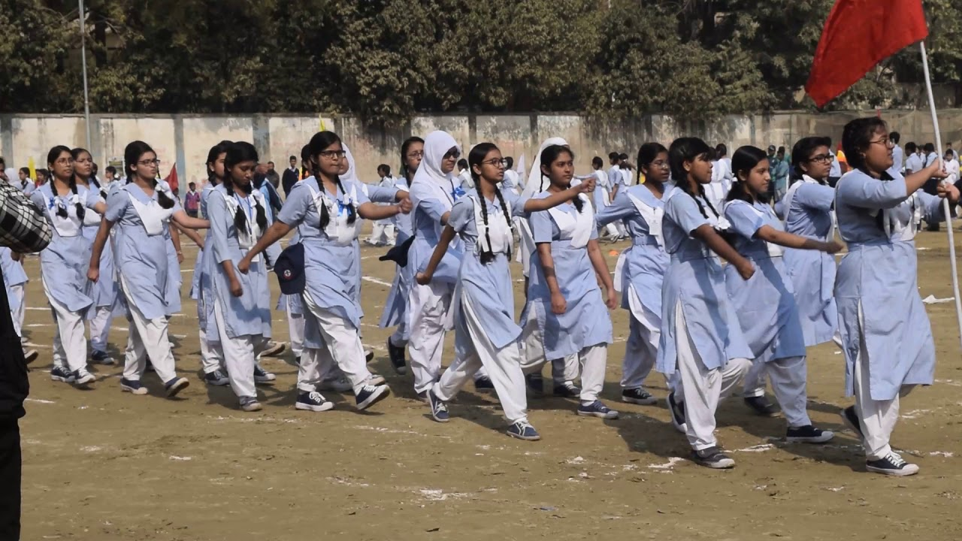
Misconceptions About Physical Education:

Slide 4
Others consider physical education as playing activity like football, hockey, races and other competitive activities whereas this is also not true. Some say it is for physical culture to make body shape. Few consider physical education is meant only for recreation, fun and enjoyment. In fact, these wrong opinions have led to many misconceptions about the subject. Few of the misconceptions are as under:

Slide 5
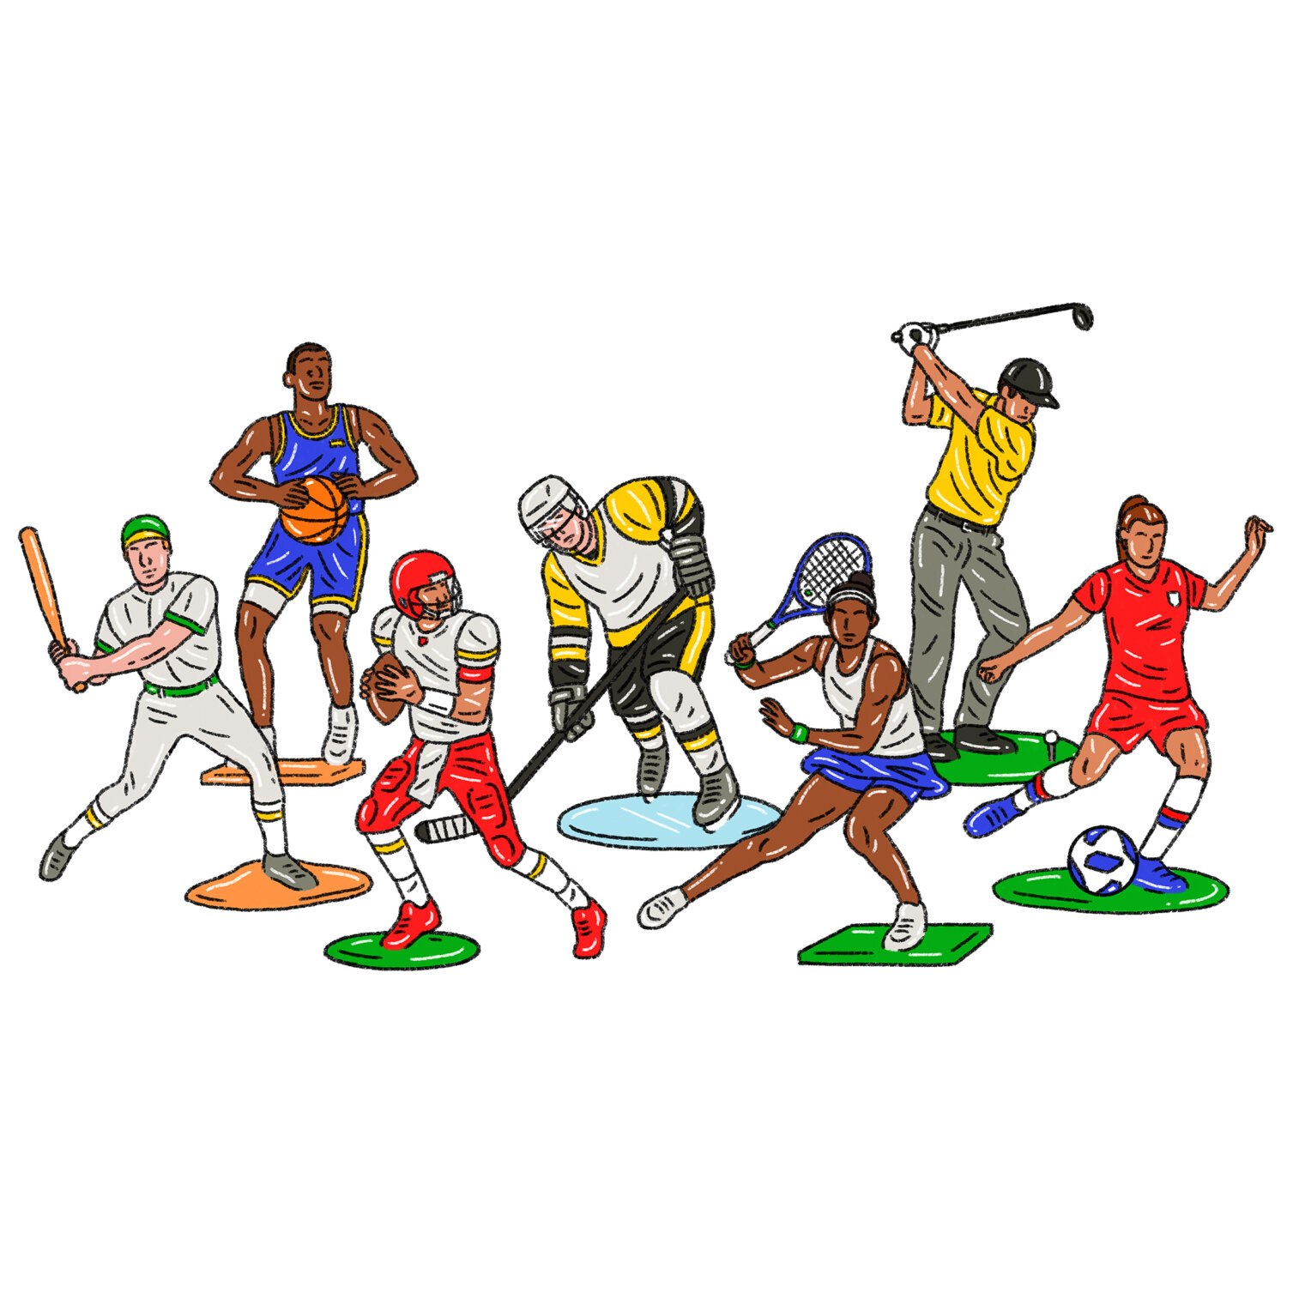

Slide 6
(i) Time Pass Activities
People think that this is a rest period as it does not have any academic value. This opinion is also wrong as this subject is very demanding in coming time and has academic value. It has its curriculum which involves theory as well as practical in it. Thus, it is not a rest or free period. Its approach improves the health status at individual and community levels.

Slide 7
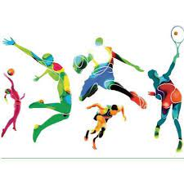
Time Pass Activities

Slide 8
(ii) Wastage of Money
Games and sports require special type of equipment, apparatus, playfield, etc. which are costly. These days many facilities are provided by the government in the form of scholarships, awards and stipends to the sports persons. The government has set up various institutions which provide free education, diet, equipment, etc. to good sportsmen.

Slide 9


Slide 10
(iii) Leads to Indiscipline
This opinion is totally wrong. A good sportsman always behaves in a disciplined manner and follows rules and regulations on the sports field and in real life.

Slide 11
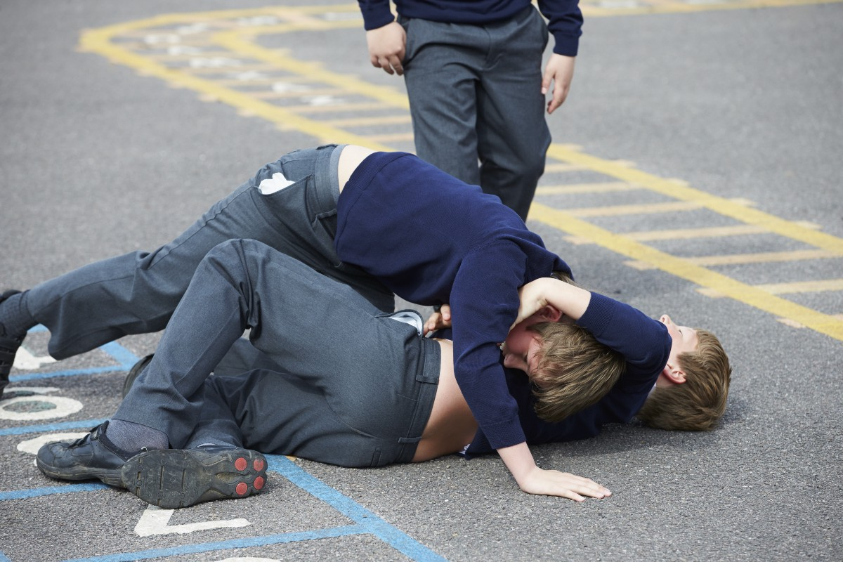
Leads to Indiscipline

Slide 12
(iv) No Job Career or Profession
Today special attention is given to sportspersons for selection in various competitive examinations. There are many jobs for sportspersons in various departments. In many professions sportsmen are accepted happily.

Slide 13

No Job Career or Profession ?
TEACHER
PEROFESSOR

Slide 14
(v) Poor Social Status
Participation in physical activities is generally considered to be for those who have poor social status and are not given any recognition by society. Whereas, this trend is now changing. Today there are many sports awards like Arjuna award, Rajiv Gandhi Khel Ratna award, Padma Shree award given to sportsmen, that add to their social status.
Poor Social Status

Slide 15

Poor Social Status

Slide 16
vi) Participation in Games only
Many people think that it is participation in games and sports. Whereas, physical education enables a person to maintain health and fitness through physical activity. Games and sports are a good medium to achieve its objectives.

Slide 17
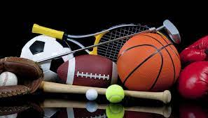

Slide 18
(vii) Wastage of Time
Many parents, students and teachers think that participation in physical activities is just a wastage of time. However, this opinion is totally wrong. It develops body and mind, as both are inter¬, related aspects of same unit. In a sound body, sound mind exists; hence if physical condition of body is good, the mental condition of the individual will also improve.

Slide 19
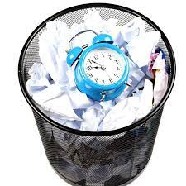
Wastage of Time

Slide 20
References
https://www.google.com/search?q=DO+PLAYING+SPORTs
https://www.theeducationmagazine.com/word-art/10-quotes-p

