Slide 1
Skill Enhancement Course (SEC)
T1
Logic and Sets
Prepared by:
Dr. Rima Barik
On 02/09/2023
Department of Mathematics
Khatra Adibasi Mahavidyalaya

Slide 2
Topics to be discussed:
Mappings:
Introduction to mappings
Types of mappings
Composite mapping
Inverse of a mapping

Slide 3
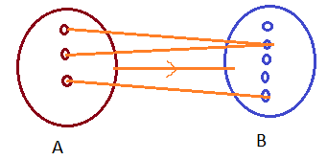
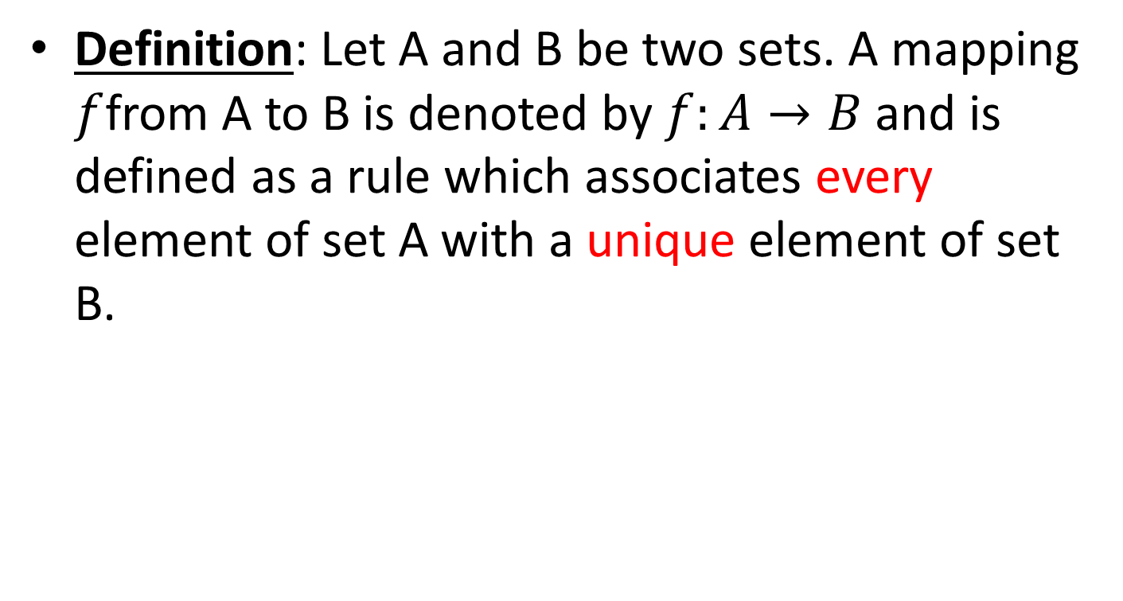
Definition: Let A and B be two sets. A mapping $f$from A to B is denoted by $f:A→B$ and is defined as a rule which associates every element of set A with a unique element of set B.

Slide 4
Points to remember
Every element of set A has an associate/image in set B.
Every element of set A has one and only one associate/image in set B.
It is not necessary that every element of set B has an associate/object in set A.
An element in set B may have no, one or more than one associate in set A.

Slide 5
Definitions
Domain : The set A is known as the domain of definition of the function f.
Codomain : The set B is known as the codomain of the function f.
Range : The subset of the set B, containing only those elements of B who are images of some elements in set A, is known as the range of the function f.

Slide 6
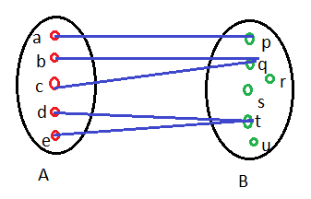
Explaining Range
Range of the mapping = {p,q,t}

Slide 7
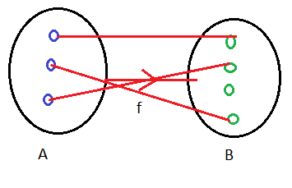

Types of Mappings
Injective Mapping: A mapping $f:A→B$ is called injective if every distinct element of set A has distinct images in set B.

Slide 8
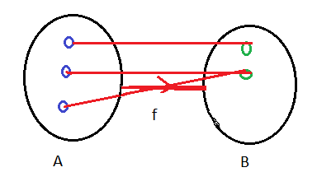

Types of Mappings contd.
Surjective Mapping: A mapping $f:A→B$ is called surjective if every element of set B is an image of some element in set A.

Slide 9
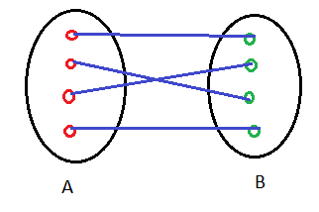

Types of Mappings contd.
Bijective Mapping: A mapping $f:A→B$ is called bijective if it is both injective and surjective.

Slide 10
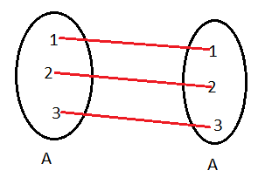

Types of Mappings contd.
Identity Mapping: A mapping $f:A→A$ is said to be an identity mapping if $f\left(x\right)=x.$

Slide 11
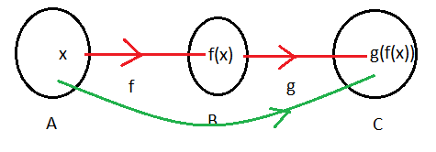

Composition of Mappings
Let A,B and C be three sets.
Let $f:A→B$ and $g:B→C$ be two mappings.
Then ${(g}_{o}f):A→B$ is the composition of the mapping g on f, defined as ${(g}_{o}f)\left(x\right)=g(f\left(x\right))$

Slide 12
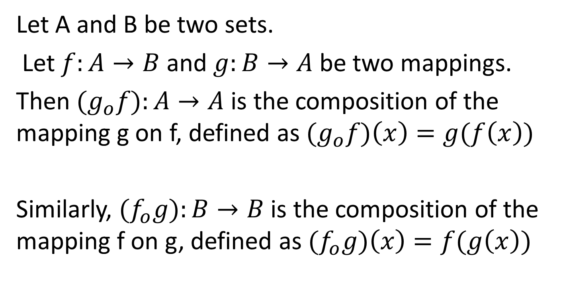
Composition of Mappings contd.
Let A and B be two sets.
Let $f:A→B$ and $g:B→A$ be two mappings.
Then ${(g}_{o}f):A→A$ is the composition of the mapping g on f, defined as ${(g}_{o}f)\left(x\right)=g(f\left(x\right))$
Similarly, ${(f}_{o}g):B→B$ is the composition of the mapping f on g, defined as ${(f}_{o}g)\left(x\right)=f(g\left(x\right))$

Slide 13
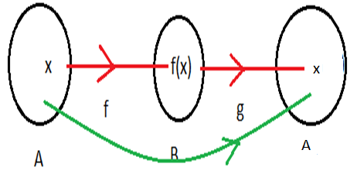
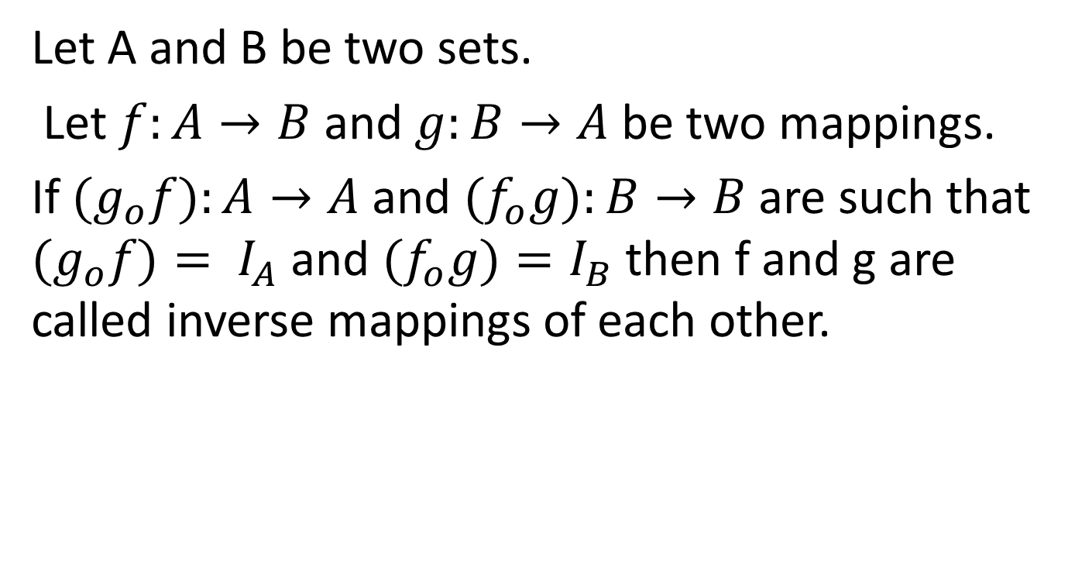
Inverse of a Mapping
Let A and B be two sets.
Let $f:A→B$ and $g:B→A$ be two mappings.
If ${(g}_{o}f):A→A$ and ${(f}_{o}g):B→B$ are such that ${(g}_{o}f)= I_{A}$ and ${(f}_{o}g)=I_{B}$ then f and g are called inverse mappings of each other.

