Slide 1

COURSE: B.Sc. (PROGRAMME) IN ECONOMICS
PAPER NAME – MICROECONOMICS-I
TOPIC – ISOQUANT
YEAR- FIRST SEMESTER-1 SESSION -2020-2021
DATE OF LECTURE: 17/02/2021
PREPARED BY
DR. KAMALIKA CHAKRABORTY
ASSISTANT PROFESSOR (DEPARTMENT OF ECONOMICS)
KHATRA ADIBASI MAHAVIDYALAYA, BANKURA, WEST BENGAL

Slide 2
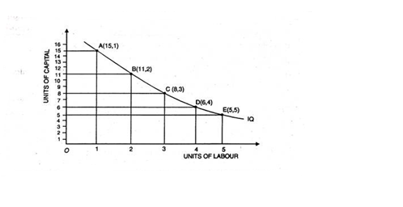
DEFINITION: ISOQUANT
An isoquant is a curve which shows various combinations of inputs for which output remains the same.

Slide 3
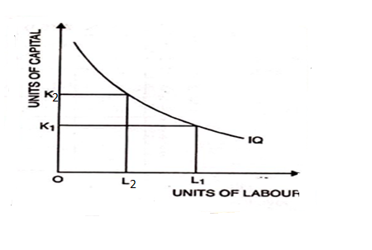
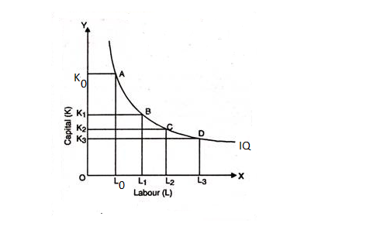
The properties of isoquant are the following:
i) Isoquants are negatively sloped.
ii) Isoquants are convex to the origin.

Slide 4
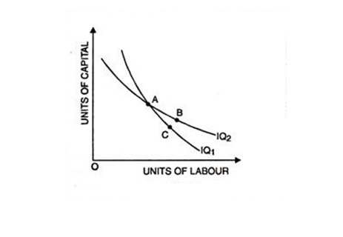
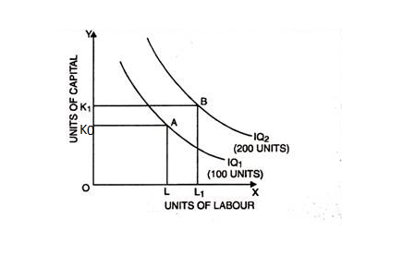
The properties of isoquant are the following(contd.)
iii) No two isoquants can cut or touch each other.
iv) Higher isoquants denote higher level of output.

Slide 5
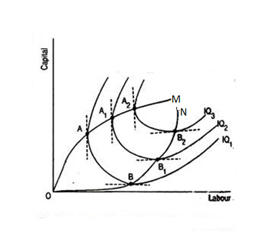
Economic region of production
Only the negatively sloped segment of the isoquant is relevant for production or economically feasible. In this segment input substitution takes place and marginal productivities of both the factors are positive. This region is called Economic region of production.

Slide 6
THANK YOU

