Slide 1

COURSE: B.Sc. (PROGRAMME) IN ECONOMICS
PAPER NAME – MACROECONOMICS-I
TOPIC-INFLATION
YEAR- FIRST SEMESTER- 2 SESSION- 2020-2021
DATE OF LECTURE : 3/06/2021
PREPARED BY
DR. KAMALIKA CHAKRABORTY
ASSISTANT PROFESSOR (DEPARTMENT OF ECONOMICS)
KHATRA ADIBASI MAHAVIDYALAYA, BANKURA,WEST BENGAL

Slide 2
What is inflation?
Inflation is the increase in the general price level over a period of time.

Slide 3
Different types of inflation
Demand Pull inflation
Cost Push inflation
Creeping inflation
Walking inflation
Galloping inflation
Hyperinflation

Slide 4
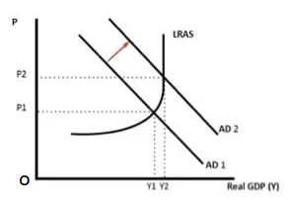
Demand Pull inflation and its causes
Demand pull inflation arises due to rise in demand for goods and services
Causes
Inflation Forecasts
Economic Growth
Rise in exports
Rise in government spending
Exorbitant rise in supply of money

Slide 5
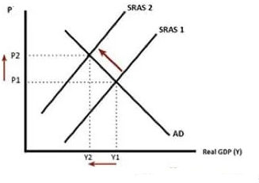
Cost Push inflation and its causes
Cost push inflation occurs when prices rise due to rise in cost of production and higher cost of raw materials
Causes
Increased taxes
Increase in wages
Scarcity in supply of raw materials

Slide 6
Effects of inflation
Effects on production
Effects on distribution of wealth and income
Effects on earning and employment
Effects on government investment
Effects on progress
Effects on purchasing power

Slide 7
Measures to control inflation
Monetary measures
Fiscal measures
Other measures
Bank rate
CRR
SLR
Open Market Operations
Repo rate
Reverse Repo rate
Demonetization
Issuing new currency
Fixed Margin Requirement
Moral Suasion
Reduction in government expenditure
Increase in taxes
Increase in savings
Public debt
Increase in production
Price control
Rational wage Policy

Slide 8
THANK YOU

