Slide 1
KHATRA ADIBASI MAHAVIDYALAYA
B.A Program in Physical Education
Subject- Physical Education
Name of the Teacher- TITHI ROY
Semester - III
Course Title: Yogasana and Gymnastics
Topic: YOGASANA
Session: 2020-21

Slide 2

YOGA

Slide 3
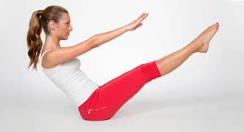
Naukasana

Slide 4
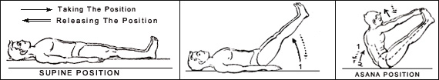
Naukasana(Step by Step)

Slide 5
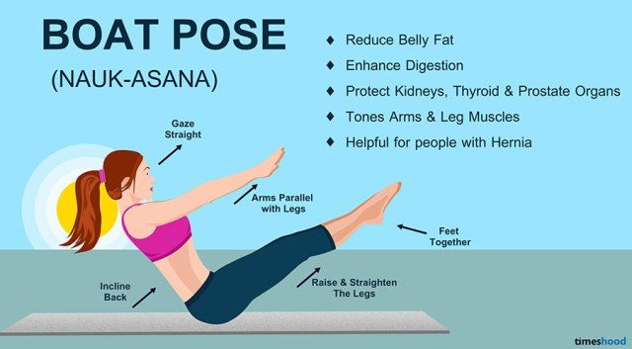

Slide 6
Step-by-Step Guide to Do Naukasana
First lie down flat on your yoga mat, with your feet together and your arms on the sides.
Keep your arms straight and your fingers outstretched towards your toes.
Start Inhaling and as you exhale, lift your chest and feet off the ground, stretching your arms towards your feet. Feel the tension in your stomach area as the abdominal muscles contract.
Let the weight of your body rest entirely on the buttocks. Make sure your eyes, finger and toes are all in one line. Hold your breath and remain in this position for a few seconds.
Now exhale slowly as you bring the body down to the starting position and relax. You can perform 3-4 repetitions daily but do not overdo it.

Slide 7
Benefits of Naukasana:
1. Naukasana strengthens the abdominal muscles.
2. It strengthens the muscles of the arms, thighs and shoulders.
3. It improves the health of all organs in the abdomen especially the liver, pancreas and kidneys.
4. It helps in regulating blood flow at sugar level.
5. It toughens muscles of neck, shoulder and the legs.
6. The stretching, compressing and relaxation of the abdominal region involved with Naukasana is a really good and effective way of burning belly fat if practiced on a regular basis.
7. The stimulation while performing the pose helps improve and regulate your digestion, including alleviating excessive gas and easing constipation.
8. Most importantly it acts as a distress tool, keeping your mind free and peaceful.
9. Asthma and heart patients are advised not to practice Naukasana.
10. If you have low blood pressure, severe headache and migraine, you must avoid this yoga pose.
11. People suffering from chronic diseases or spinal disorders are advised not to practice this yoga pose.
1COMMENTS12. Women should avoid it during pregnancy and also during the first two days of the menstrual cycle.

Slide 8
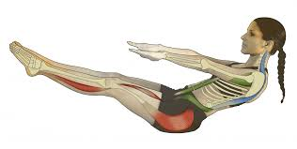
Benefits of Naukasana:

Slide 9
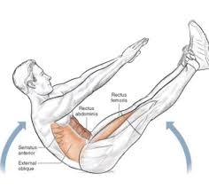
Benefits of Naukasana:

Slide 10


